Slide 1
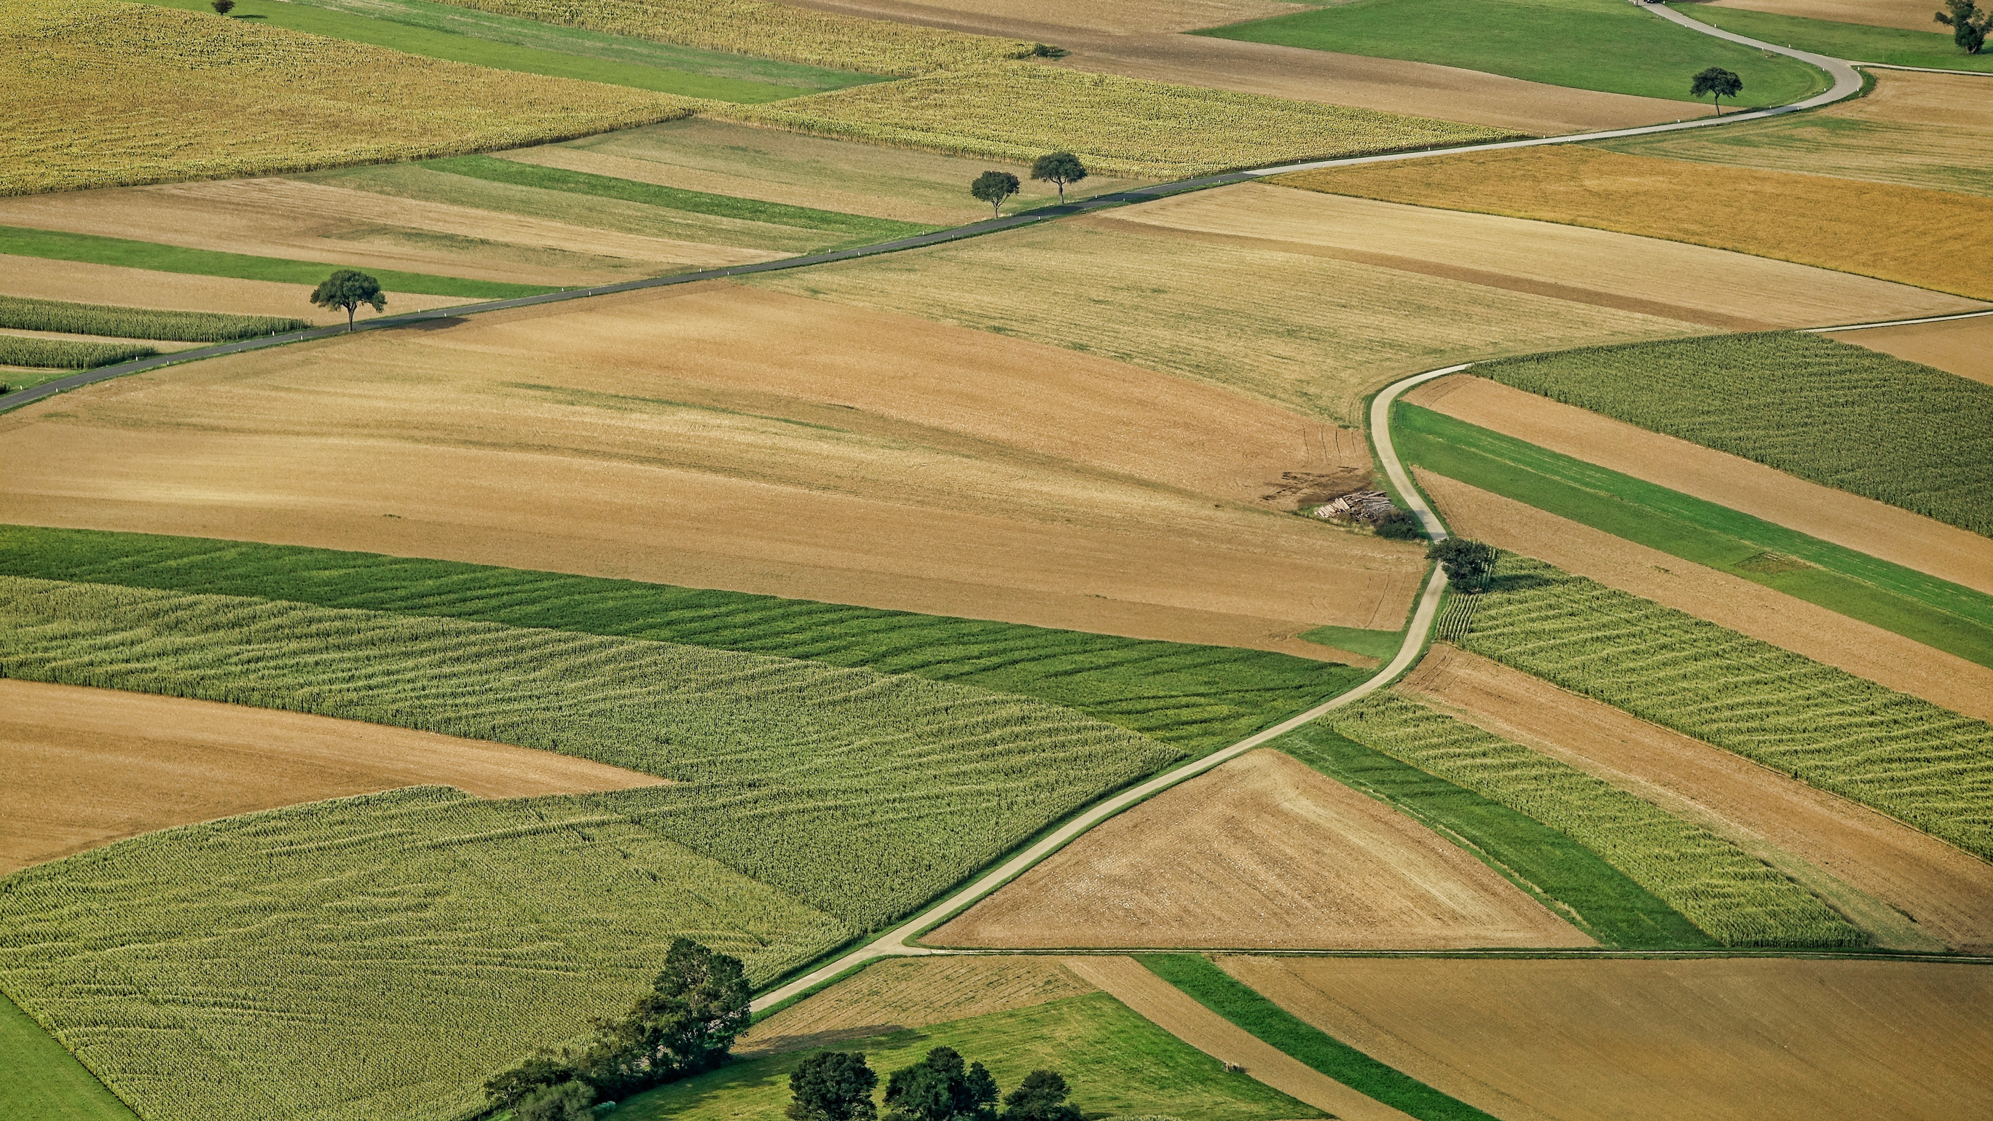

IKAT in
Farming
KARAN SINGH PATHANIA 101903072
TARUNVIR SINGH 101903202
AMRITPAL SINGH 101903334
INDERPAL SINGH 101903343
Under the Mentorship of
DR. ANIL SINGH

Slide 2
Table of Contents:
01 | Background of Project
02 | Scope & Utility
03 | Objectives
04 | Literature Survey
05 | Architecture
06 | Tools Used
07 | Hardware Model
08 | Software Model
09 | Flowchart & Design
07 | Hardware Model
05 | Architecture
06 | Tools Used
07 | Hardware

Slide 3
Table of Contents:
09 | Flowchart & Design
10 | Algorithms &Techniques
11 | Professional & Technical Learning
12 | Individual Roles
13 | Work Completed
14 | Future Scope

Slide 4
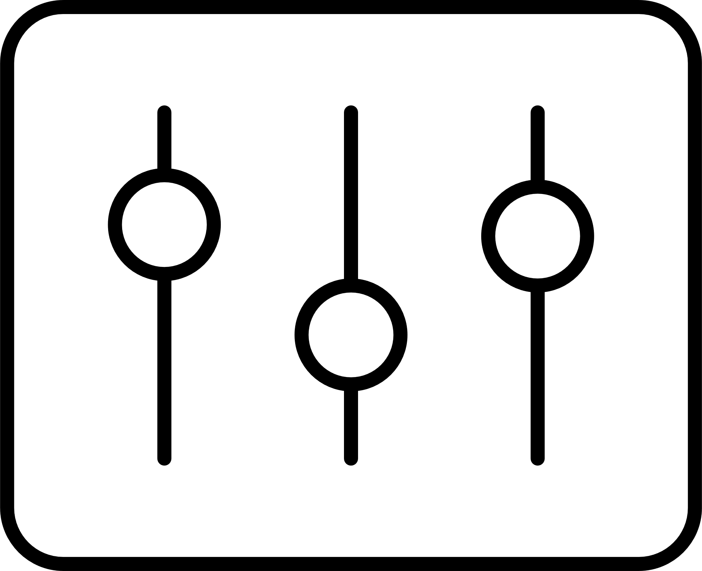


Background of Project
Involvement of technology in farming to increase productivity, as it is the backbone of Indian economy.
Sustained progress in agriculture cannot be achieved unless and until more than half of the cropped area is brought under assured irrigation.
•Building a holistic solution which could address to the needs of Indian Farmers.
•Detecting the plant diseases and ripeness of fruits using advanced machine learning models .

Slide 5
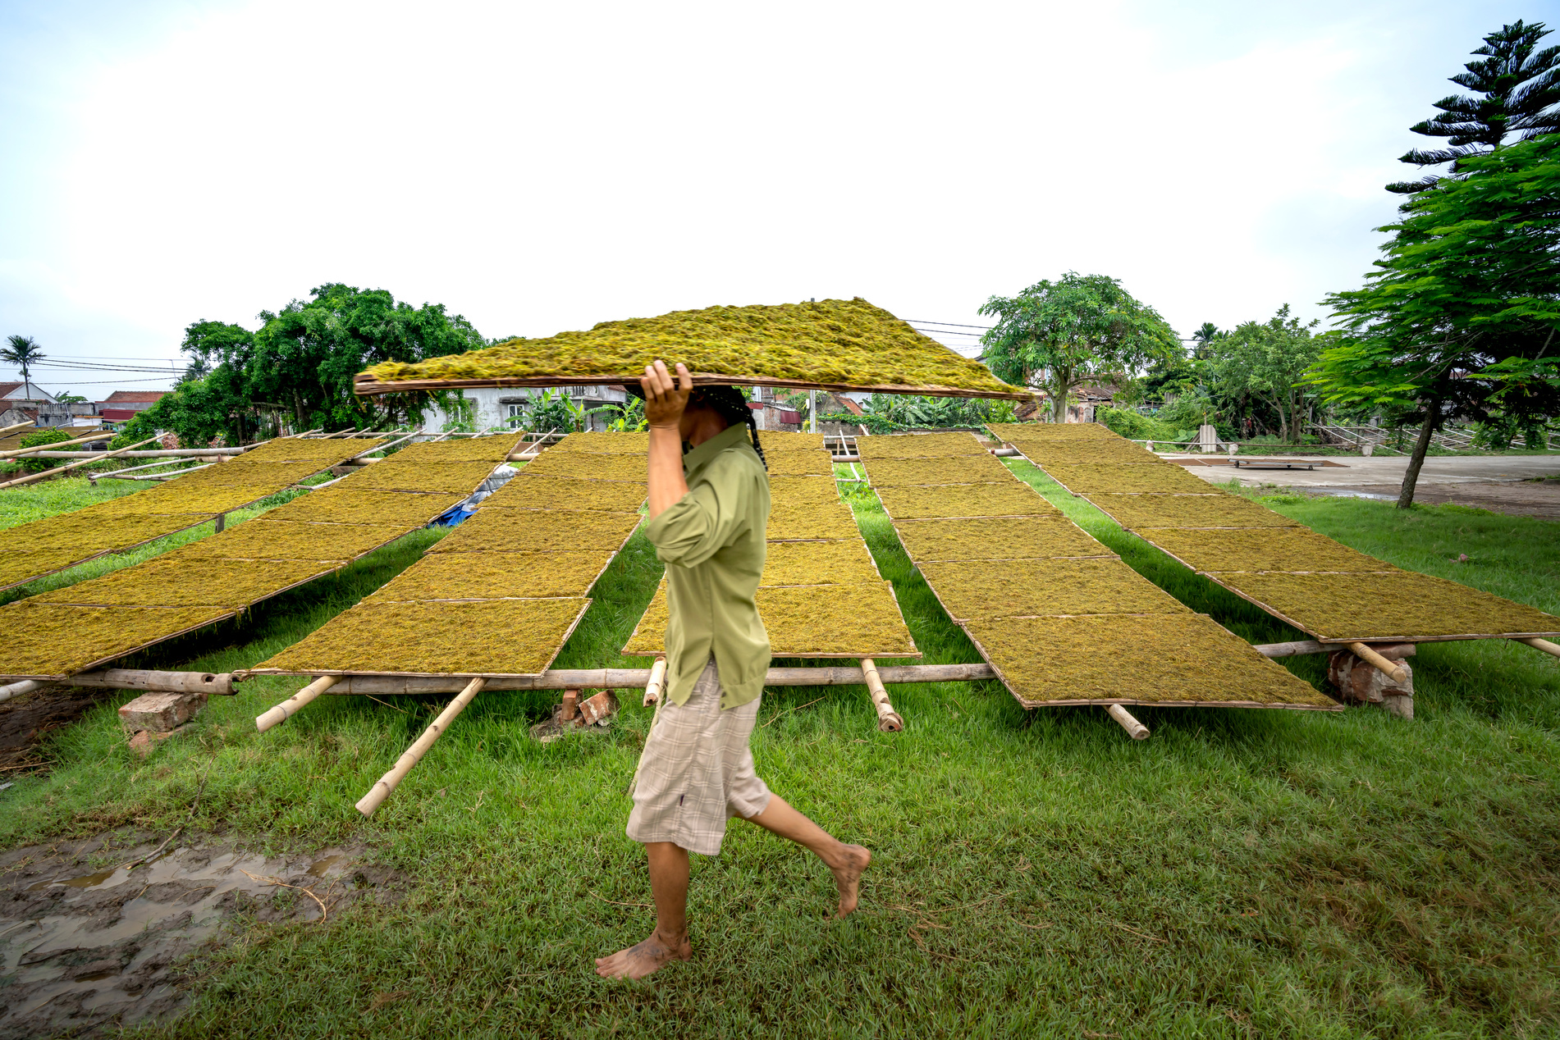
Scope and Utility of the Project
01
Crop Monitoring
02
Enhance Productivity of Farm
03
Plant phonemics and associated data analysis
04
Plant Disease Detection

Slide 6
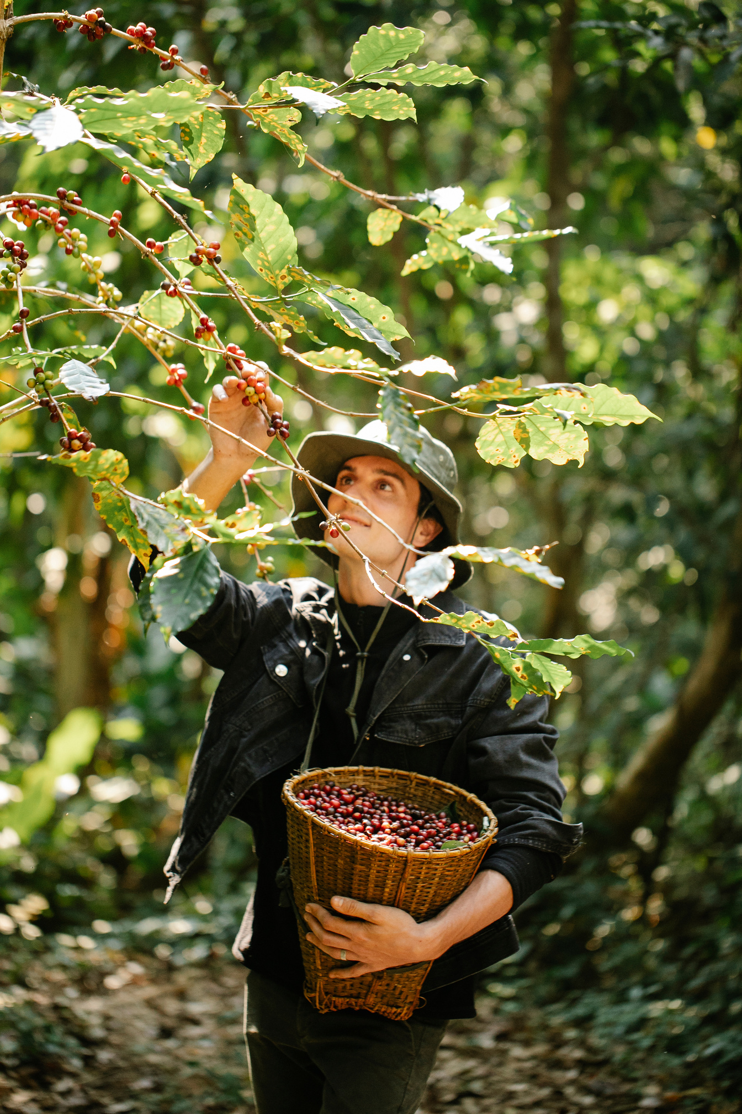
Objectives
01
Crop Prediction
02
Disease Detection in Crops
03
Automated Irrigation System
04
Website for Farmers
05
Graphical Display of Sensors Readings

Slide 7


Literature Survey
Smart Irrigation with Field Protection and Crop Health Monitoring system using Autonomous Rover
Reliable Data Fusion of Hierarchical Wireless Sensor Networks with Asynchronous Measurement for
Greenhouse Monitoring
Smart Irrigation System: IOSR Journal of Electronics and Communication
Engineering
An autonomous rover that monitors the field and, a system for identification and classification of
affected plants
Data fusion problem of wireless sensor networks for the green house monitoring system.
Water Conservation by automatically providing water to plants based on
needs.

Slide 8
Literature Survey...
Fruit Quantity and Ripeness Estimation Using a Robotic Vision System
Smart Farming Using Machine Learning
Special Issue of Second International Conference on Advancements in Research and Development
ML-ASC
performance framework proposed in the study can transform the existing production systems into data-driven smart manufacturing
systems.
A system that locates, tracks, and estimates the ripeness and quantity of fruit in
the field
A software application that provides suggestions to farmers when the hardware system
analyses the soil

Slide 9
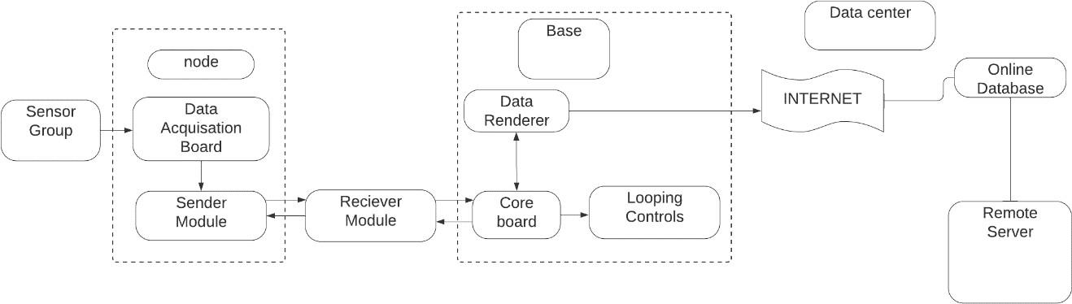
Architecture

Slide 10






Tools Used

Slide 11
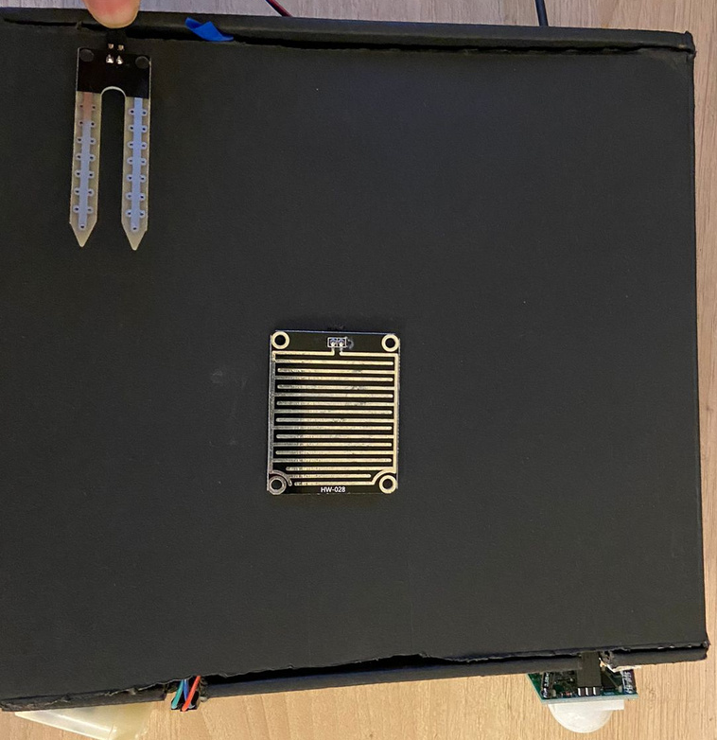
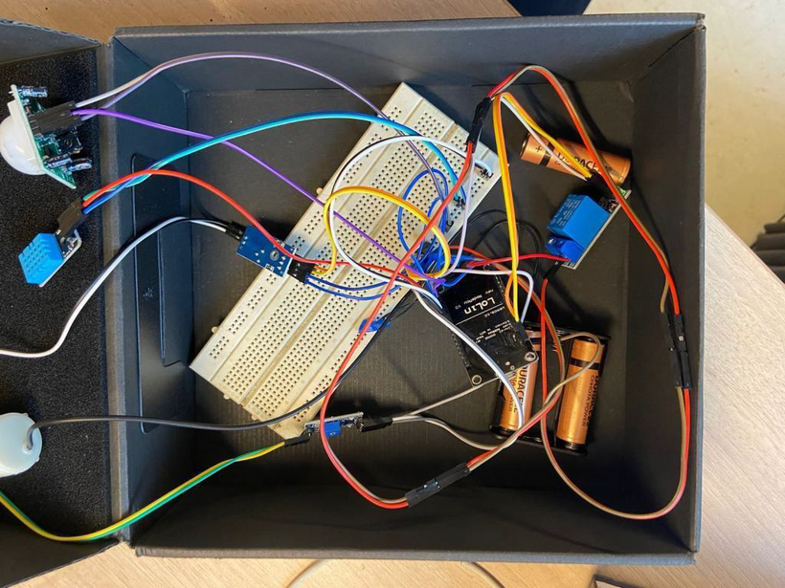
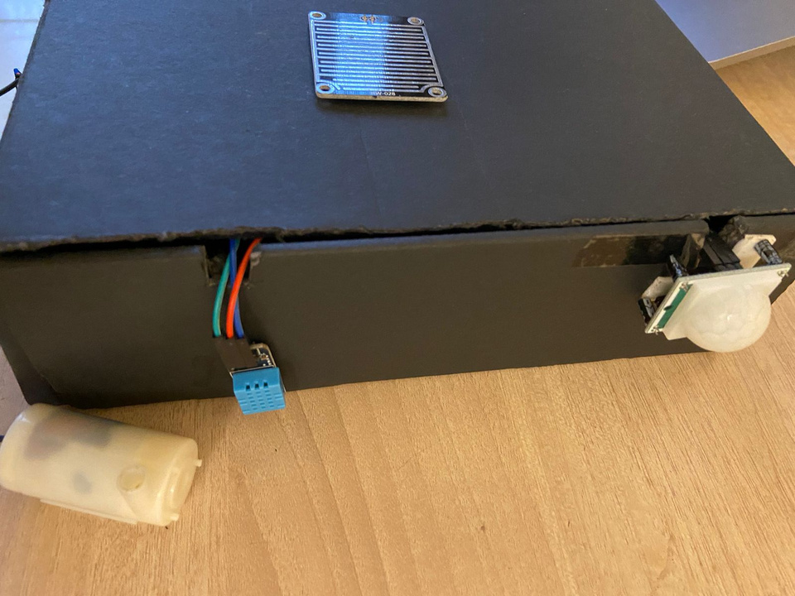
Hardware Model

Slide 12
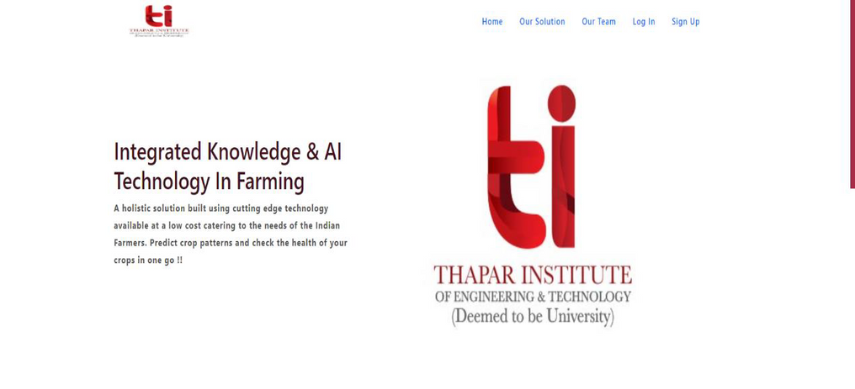
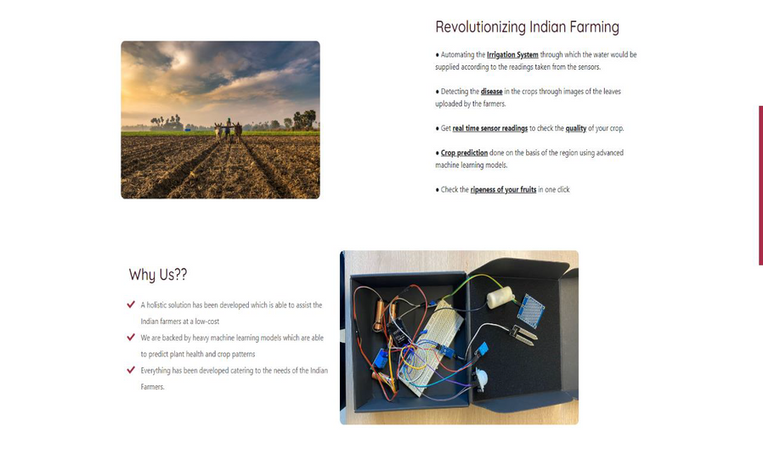
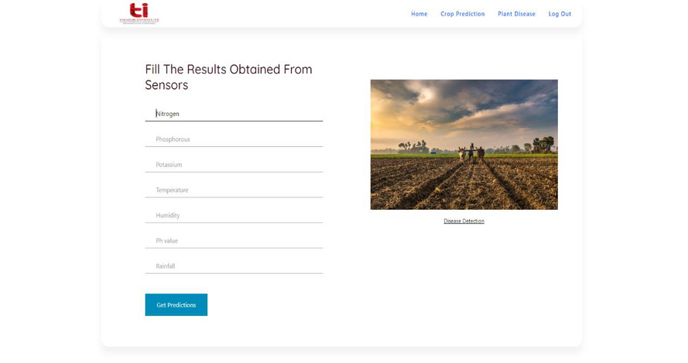
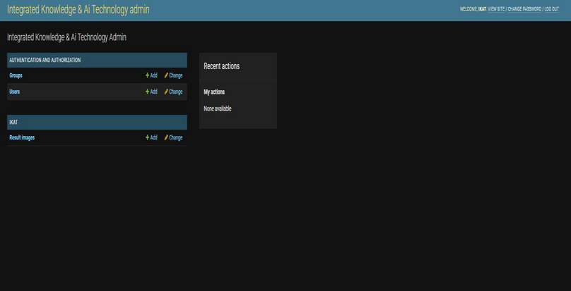
Software Model

Slide 13
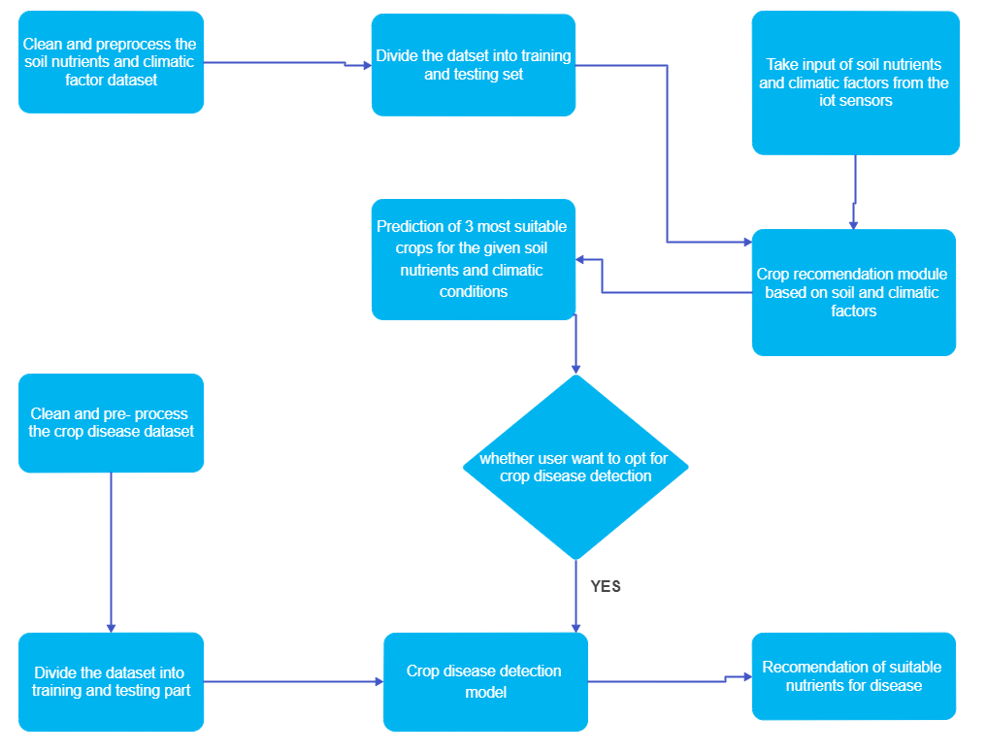
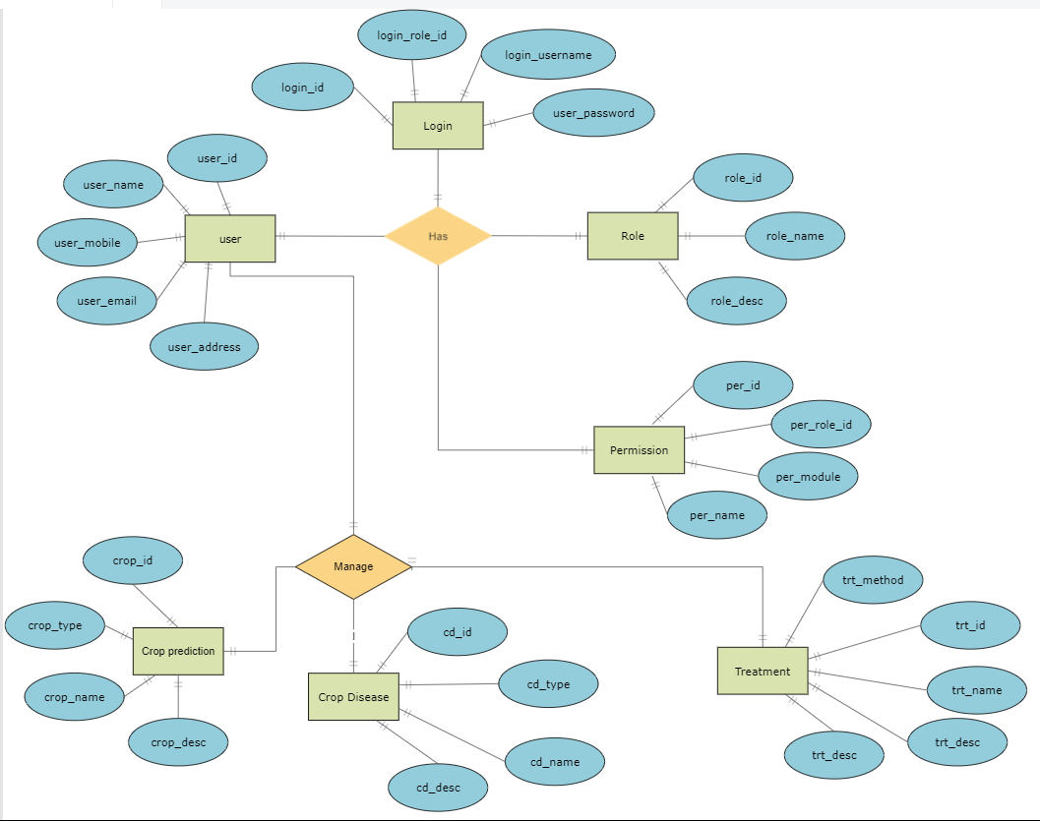
Flow chart & Design
Dataflow diagram
ER diagram

Slide 14
Algorithms & Techniques
Algorithms
Convolutional Neural Network
Extreme Gradient Boosting
K-Nearest Neighbor
Random Forest
Language & Libraries
Python
Javascript
Nvidia Rapids
Tensorflow
Scikit-learn
Arduino Library

Slide 15
Professional & Technical learning
Professional Learning
Detail analysis of research paper
Problem solving
Essence of coordinated team work
Technical Learning
Learnt to find best fit algorithm
Deployment of AI model
Hardware and Software
Integration

Slide 16
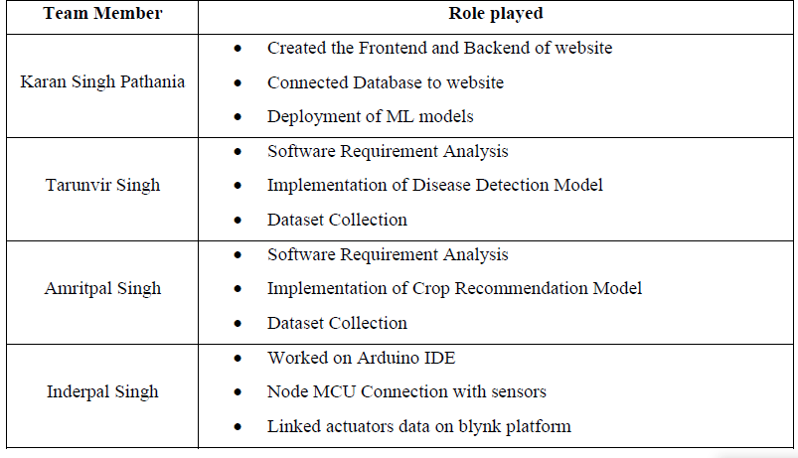
Individual Role

Slide 17
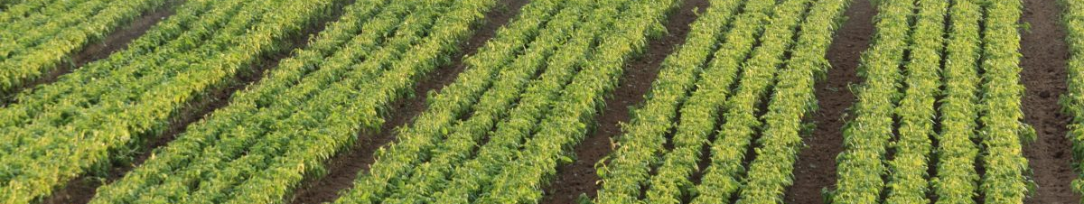
Work Completed
Web App
Crop Recommendation System
Soil Features Detection
Plant Disease Detection

Slide 18
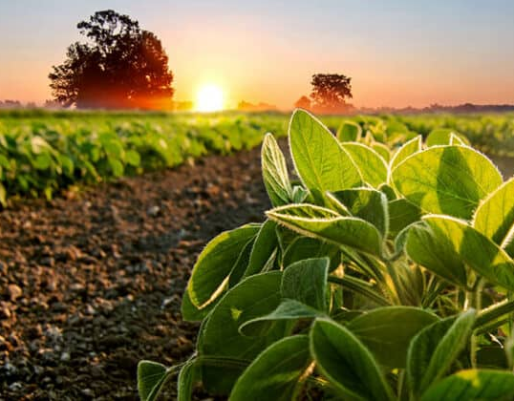
Future Scope
Increasing Accuracy
Integrate all applications
Robot car for collecting data
Providing alert system
Fruit Ripening Detection

Slide 19
Thank you
😊

